Slide 1


Biodiversity
Introductory Level

Slide 2

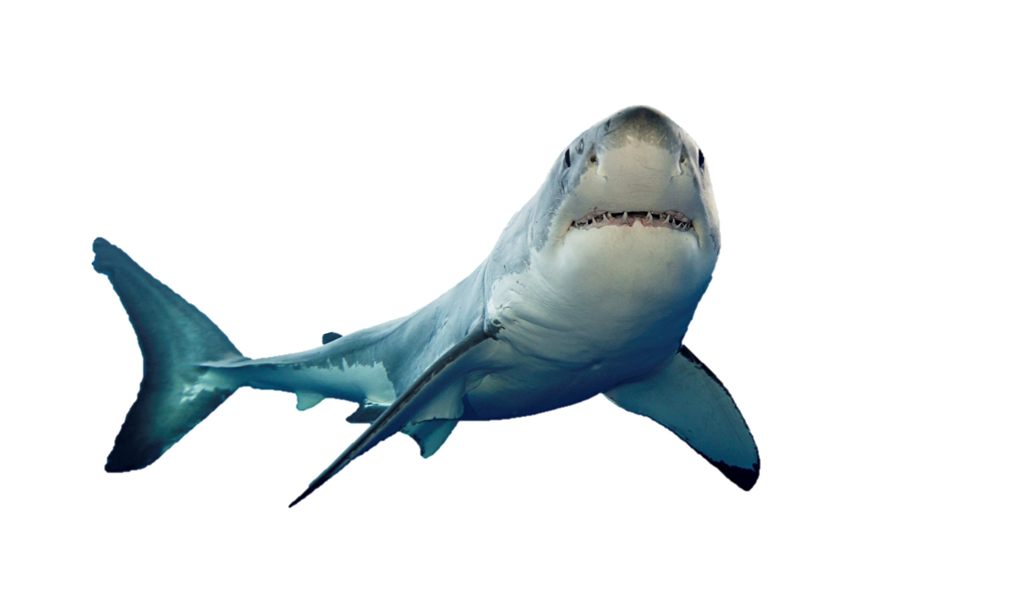
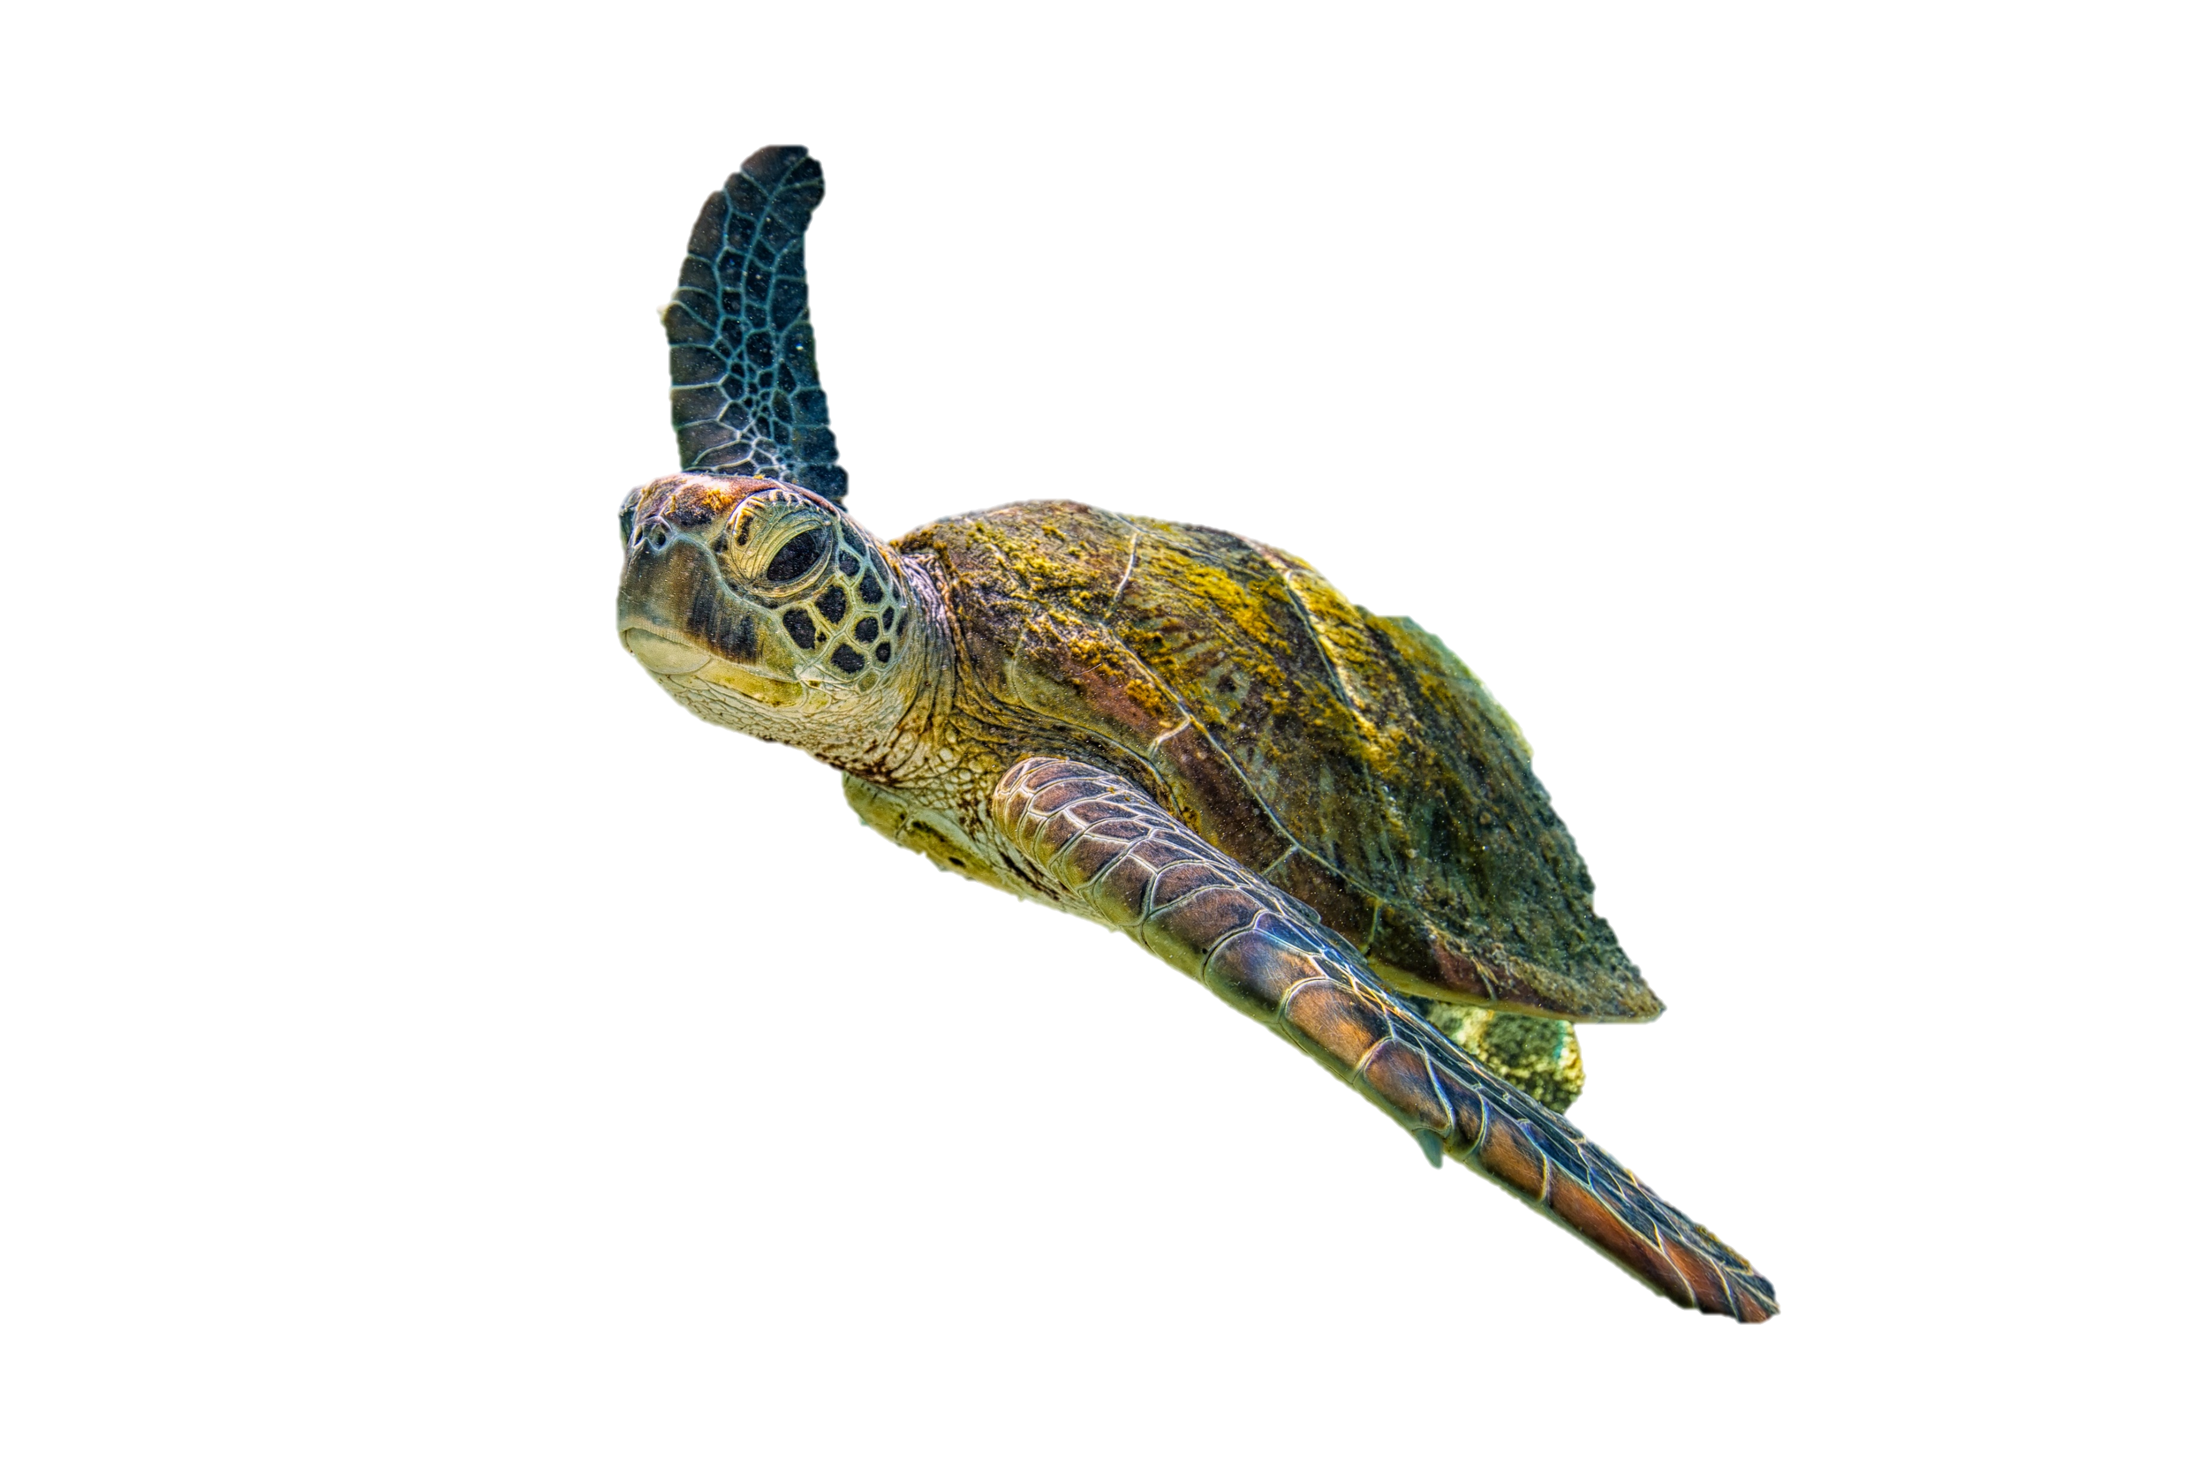

What is Biodiversity?
Think About It
Think about the word “Biodiversity”.
Take a minute and think; what is biodiversity, and what does it mean, and why is it important to humans and nature?
Then on a whiteboard write down a couple key words that describe biodiversity.

Slide 3

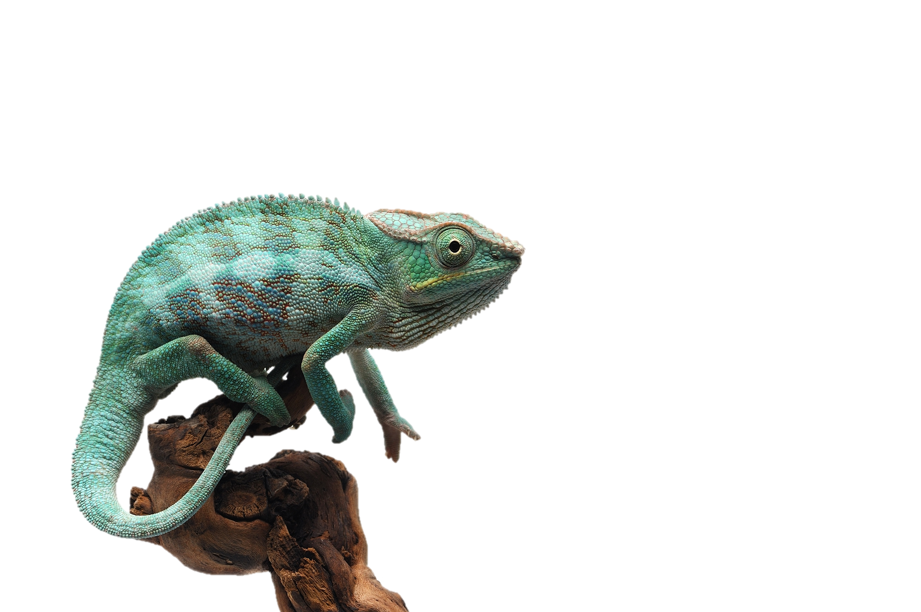
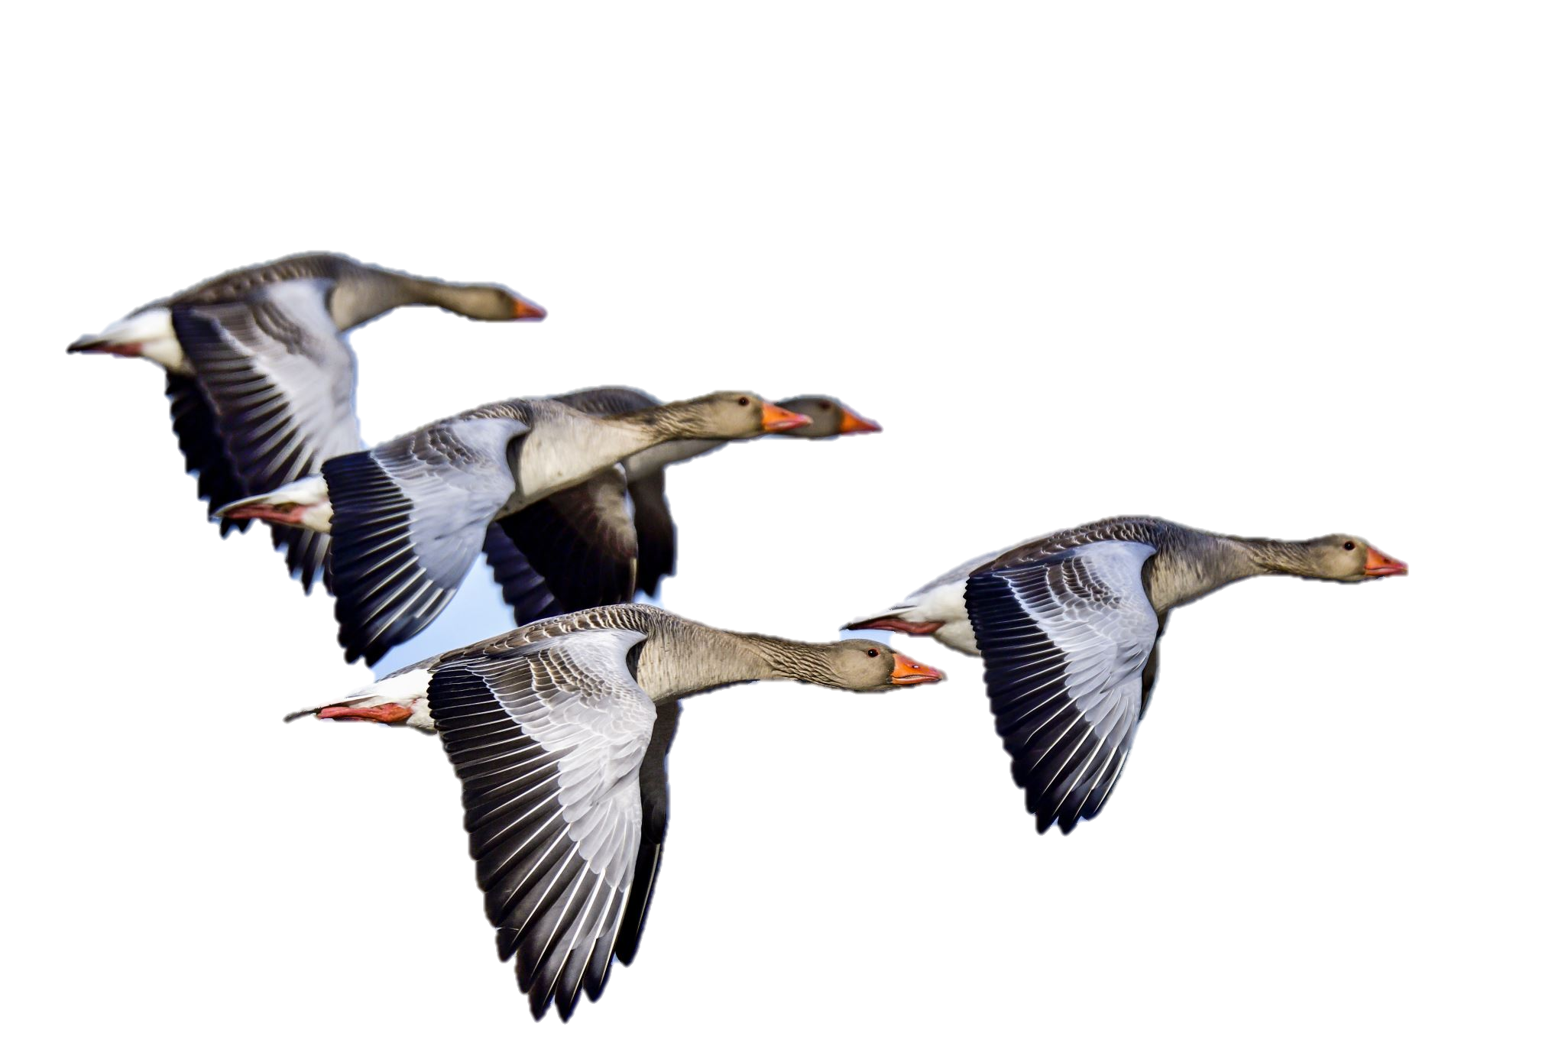
What is Biodiversity?
Teaching
If you break up the word Biodiversity, you will see the Latin root bio at the beginning.
The Latin root bio comes from the word bios meaning life.
Then you will find the word diversity, in the second part of the word.
BIO+DIVERSITY

Slide 4
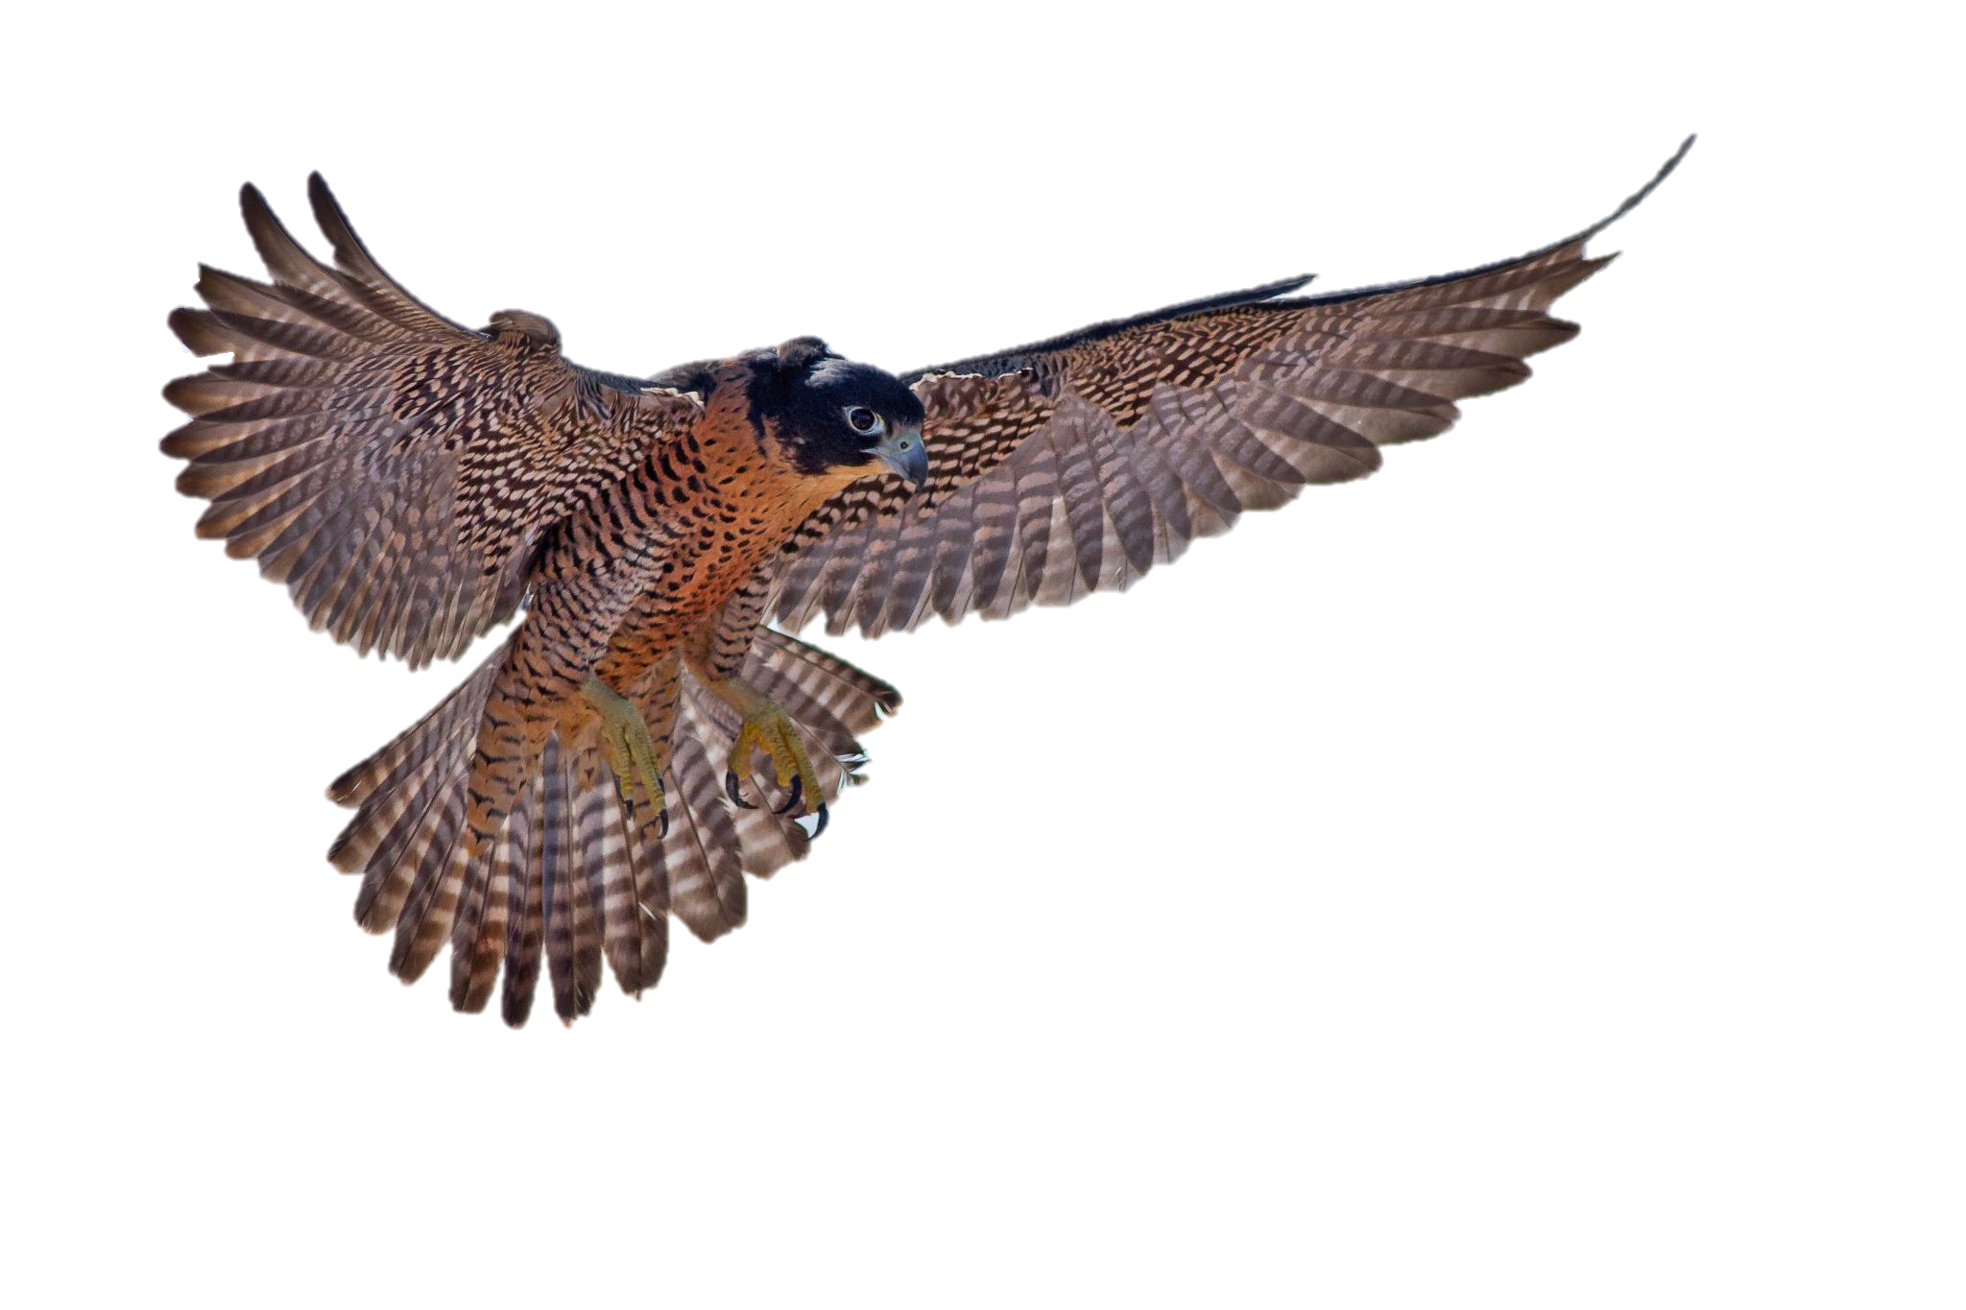

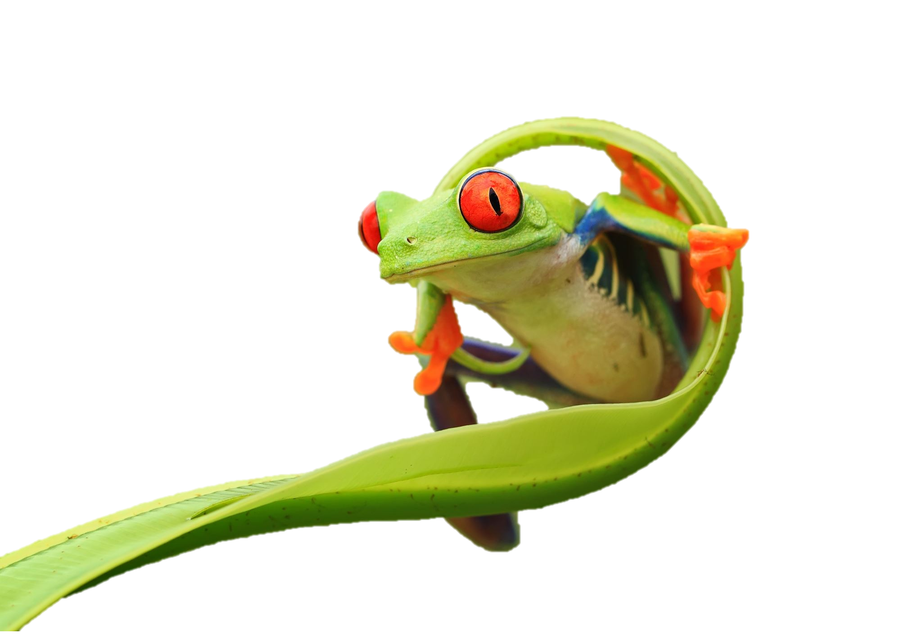

What is Biodiversity?
Activity
Individually, use paper and pencils to decorate your piece of paper showing what Earth’s biodiversity means to you.
When your done we will create a mosaic of all of your artwork.

Slide 5
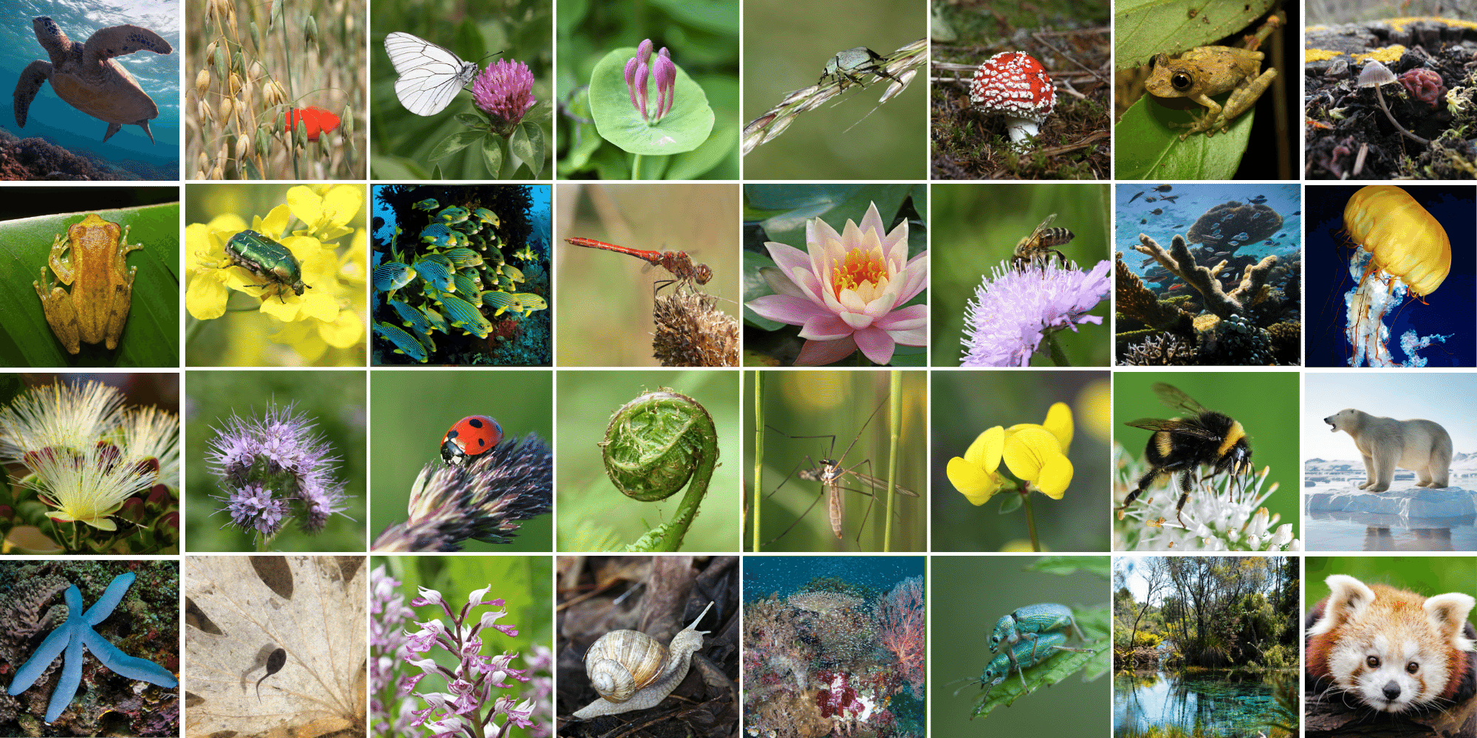

What is Biodiversity?
Discussion
Now that your done, what did you draw? Why?
Did you include animals, plants, or fungi? Well, your right!
Biodiversity: all of the different kinds of life you will find in one area, including animals, plants, fungi, bacteria, and genetic material

Slide 6
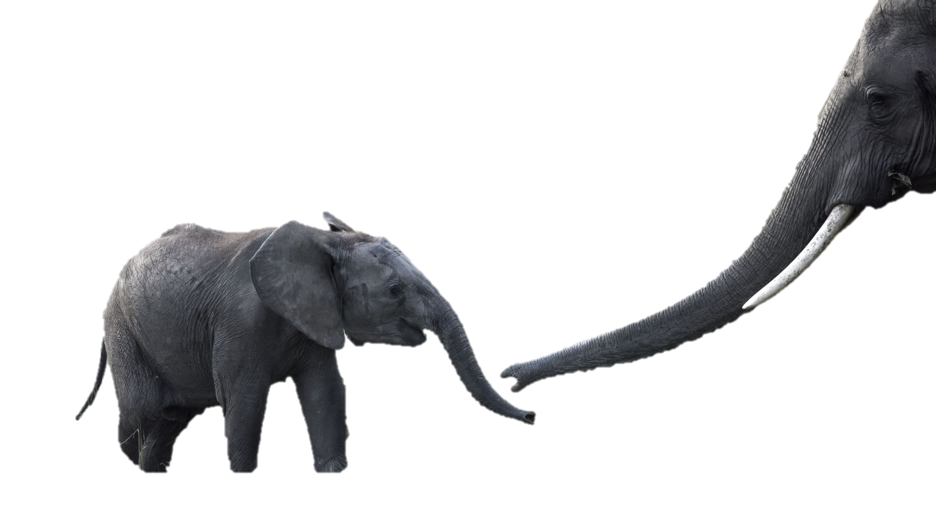
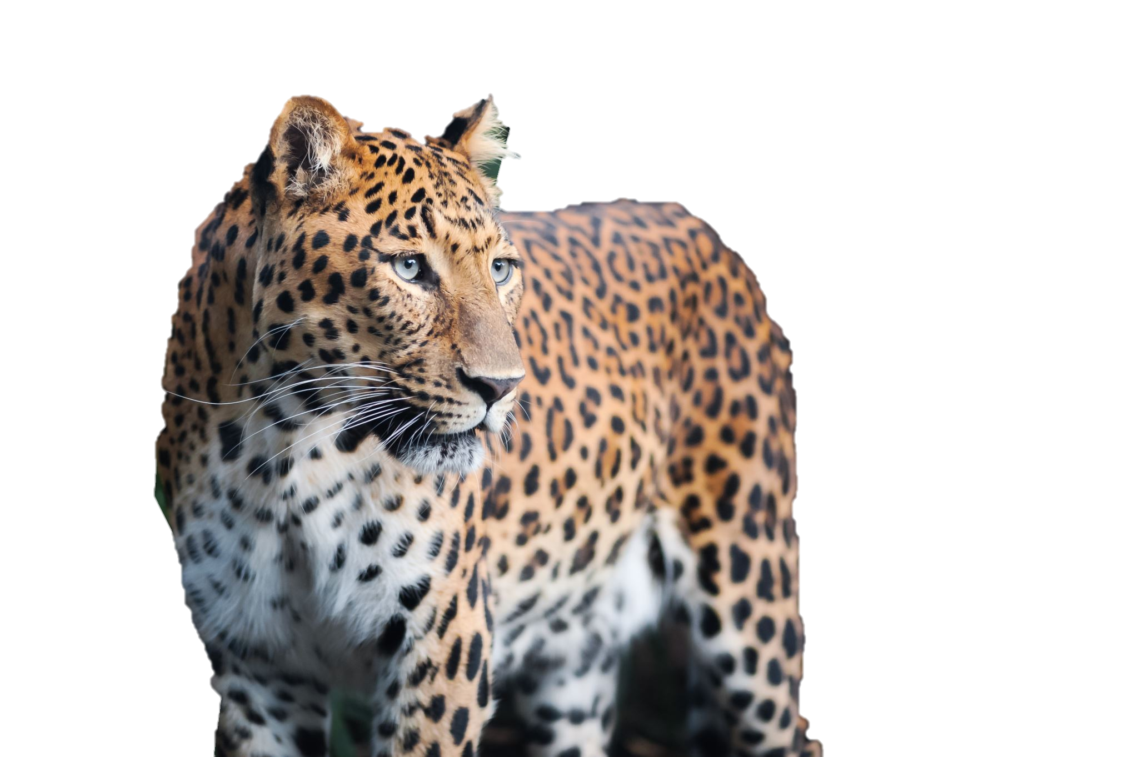
Why does it matter?
Discussion
Now that you know what biodiversity is, why do you think it matters? Take a minute and talk with your groups.
When your done, think about this question: why biodiversity is often referred to as the “web of life”? When we get back together, we will talk about it.

Slide 7

Vocabulary
Review
Let’s take a minute and review two words we’ve learned so far.
Biodiversity: all of the different kinds of life you will find in one area, including animals, plants, fungi, bacteria, and genetic material
Ecosystem: the living (plants, animals, other organisms) and nonliving (air, water, soil) components of an area that interact with each other in an interconnected way

Slide 8
Why Does it matter?
Teaching
Every plant/animal/bacteria/genetic makeup/habitat is a thread in the “web of life.” The more threads there are, the stronger the web.
As threads are removed, the web becomes weaker and eventually falls apart. Biodiversity is the framework for nature, which provides all the things we need to survive. Without biodiversity, there is no nature. And without nature, there is no humanity. In nature, everything is connected.
The ripple effect of any change touches every part of our planet.

Slide 9
Why Does it matter?
Teaching
Biodiversity across our planet has declined dramatically. Human activity has caused populations of fish, birds, mammals, amphibians, and reptiles to fall by 60% over the past 50 years.
In order to reverse this trend and bring about real change, we have to work together. This includes action at every level— governments, companies, communities, and individuals.

Slide 10
What’s causing decline?
Teaching
Biodiversity is threatened by many things combining to make a bigger issue.
A lot of the decline of diversity can be traced back to farming. Habitat destruction and of harvesting of animals are one of the leading factors.
Poor water quality and food scarcity additionally makes survival harder to, but this is also mainly traced back to types of agriculture.

Slide 11
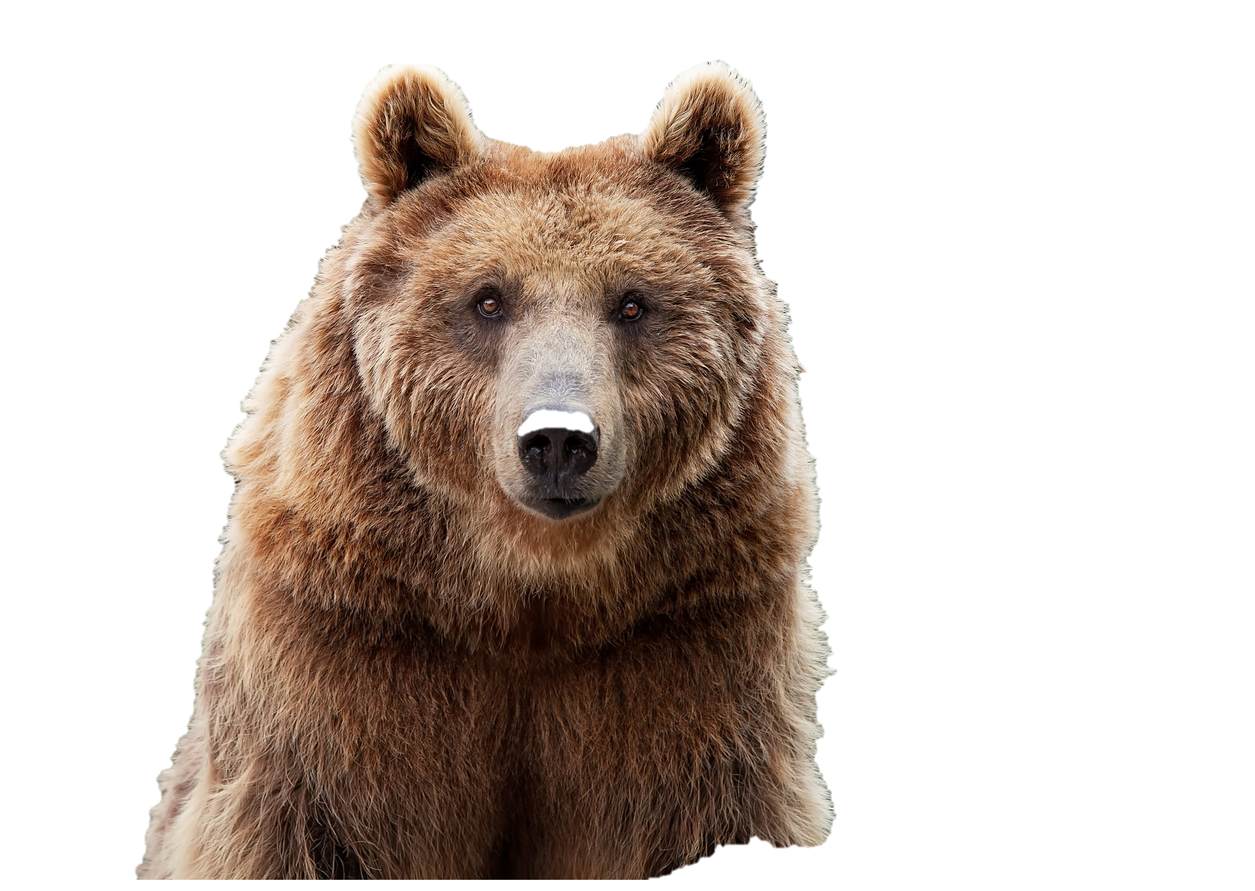
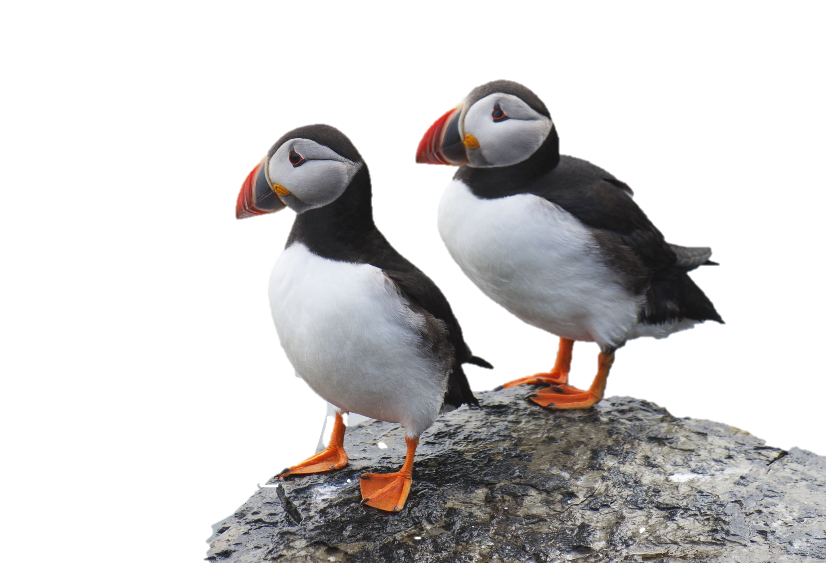
What can we do?
Discussion
Now that we know what biodiversity is, why it matters, and what is causing it’s decline let’s find out how we can protect it.
Discuss ways you could make a difference.

Slide 12
What can we do?
Teaching
Protect Nature & Raise Awareness - Speak out about biodiversity. Start eco-movements in your school or community.
Save Energy & Choose Wisely - Turn off unused devices, walk or bike, and explore renewable energy options.
Shop & Eat Sustainably - Choose certified products, reduce food waste, and follow healthy eating guidelines.
Respect Wildlife & Reduce Waste - Grow pollinator-friendly plants, use less plastic, and leave nature pristine.

Slide 13
What can we do?
Teaching
Protect Nature & Raise Awareness - Speak out about biodiversity. Start eco-movements in your school or community.
Save Energy & Choose Wisely - Turn off unused devices, walk or bike, and explore renewable energy options.
Shop & Eat Sustainably - Choose certified products, reduce food waste, and follow healthy eating guidelines.
Respect Wildlife & Reduce Waste - Grow pollinator-friendly plants, use less plastic, and leave nature pristine.

Slide 14
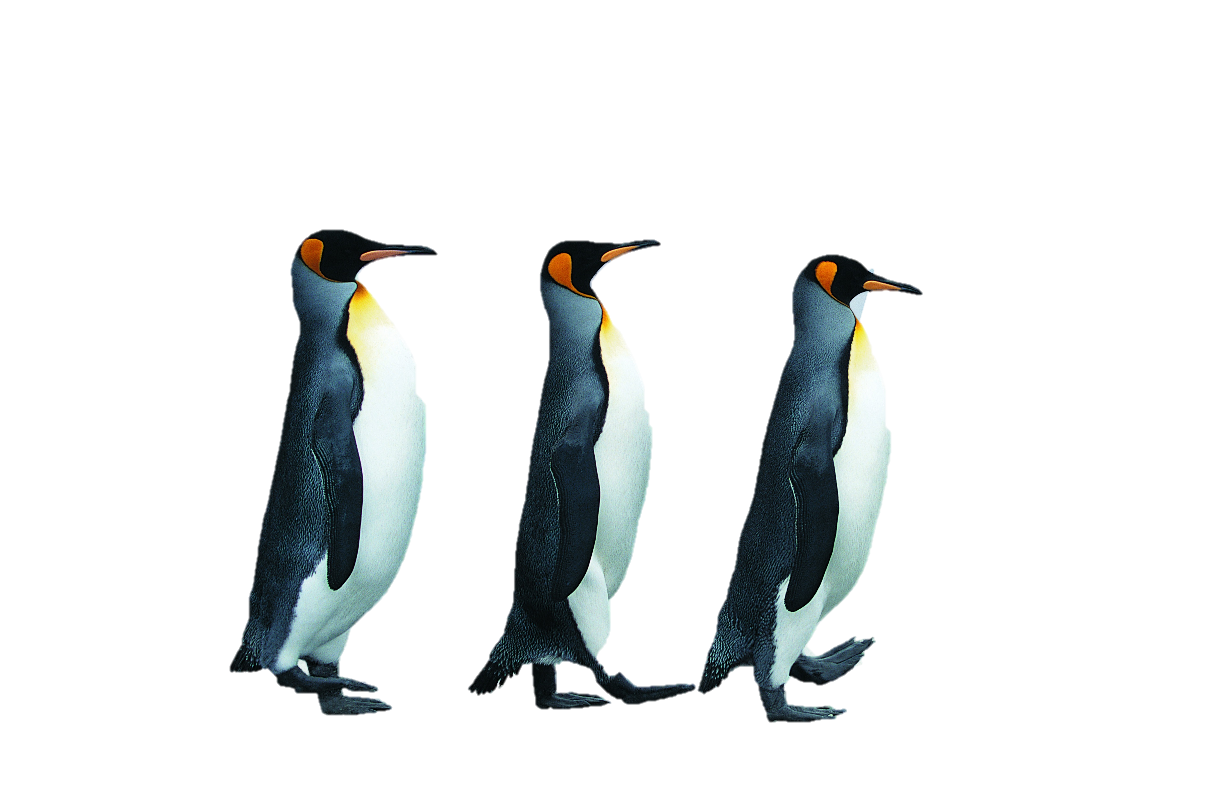
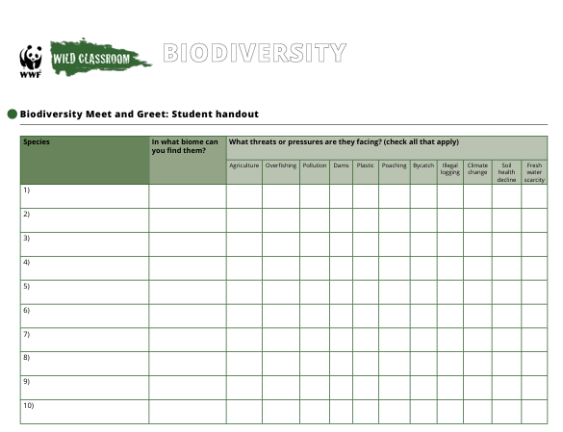
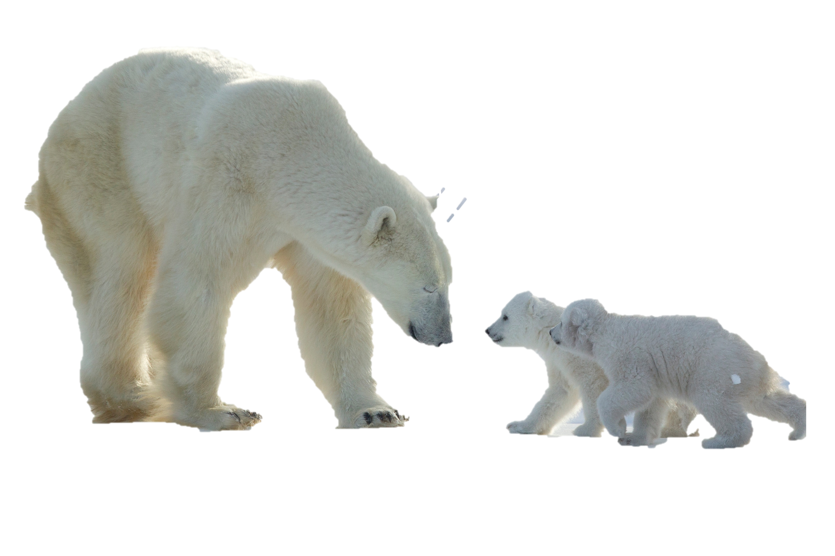
BioBlitz
Activity
Using the provided instructions and equipment, participate in an insect BioBlitz to study Biodiversity.
Fill out the provided worksheet.

Slide 15

So, what have we learned?
Summary
Biodiversity is the variety of life on Earth—from small species to entire ecosystems.
Biodiversity is essential because it supports ecosystem services like clean air, water, pollination, and climate regulation.
However, it's under threat from habitat loss, pollution, climate change, and overexploitation.
We can protect it by everyday things by raising awareness, saving energy, shopping & eating sustainably, respecting wildlife and reduce waste.

Slide 16
Credits
Information
“Green Tips.” World Wildlife Fund, www.worldwildlife.org/pages/green-tips. Accessed 11 Oct. 2025.
Images
“Stock Images.” IStockPhoto.com, www.istockphoto.com. Accessed 12 Oct. 2025.
Copyright 2025 Greening Spring Branch | Made in affiliation with World Wildlife Fund Wild Classroom

